Slide 1
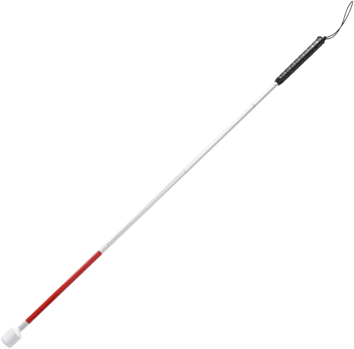
Walking stick for blind
EEE F411
INTERNET OF THINGS
Group Members:
1. Devesh Mittal (2020A8PS0570P)
2.Isha Srivastava (2019B1A31034P)
3.Nehal Gupta (2019B1A80990P)
4.Nishtha Pareek (2019B1A81044P)
5.Richa Prasad (2019B5A80732P)

Slide 2
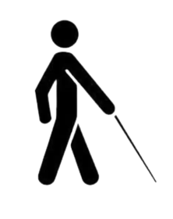
Project Motivation
This is a smart technology assisted stick for the assistance of blind people
People who suffer from a severe reduction in vision that cannot be corrected with conventional means, such as refractive correction or medication and reduces a person’s ability to function at certain or all tasks.
Presently Blind people use a white stick as a tool for detection, when they move or walk.
Here we have tried to develop a smart tool which can serve as a blind stick being more efficient and helpful than the conventional one.

Slide 3
01
02
Table of Contents
03
04
05
06
PROBLEM STATEMENT
WHY USING IOT
COMPONENTS USED
CIRCUIT AND DESIGN
Budget
BLOCK DIAGRAM

Slide 4
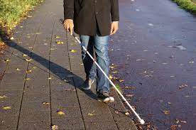
2.2 Billion
Globally 2.2 billion people in this world have vision impairment
Feel dependent on others
Miss out on opportunities
Struggle with some day to day activities
Can be used by elderly

Slide 5

IOT based
Solution
Normal Walking stick- performs basic functionality only.
Would help them to navigate and roam around.
Would not only detect the presence of an object ahead but also detect what object is present in front.
Would help the person to find their walking stick
In case of emergency can be used to send an SOS signal.

Slide 6
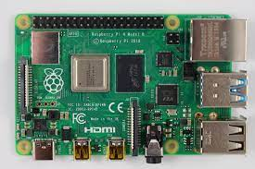
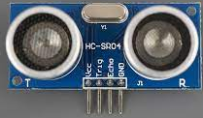
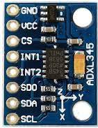
HARDWARE USED
Raspberry Pi4
Ultrasonic Sensor HC-SR04
Accelerometer ADXL 345
Logitech Webcam
3-Pin Buzzer
GPS Neo 6M Module

Slide 7

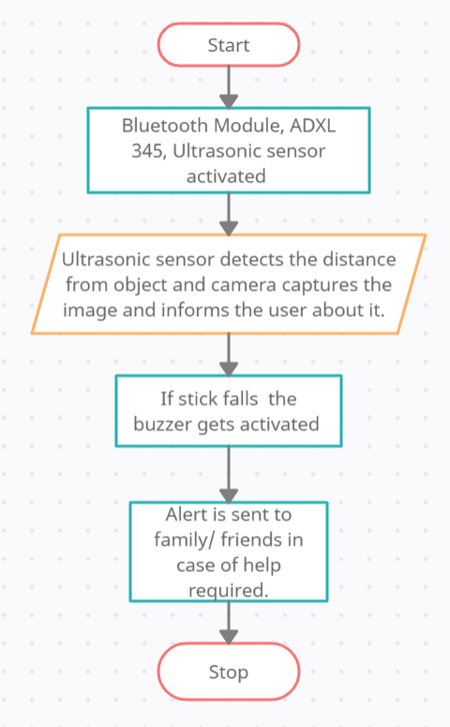
BLOCK DIAGRAM

Slide 8
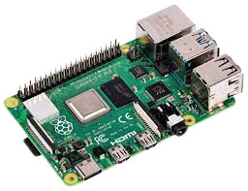
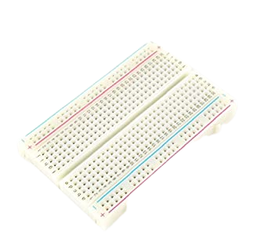
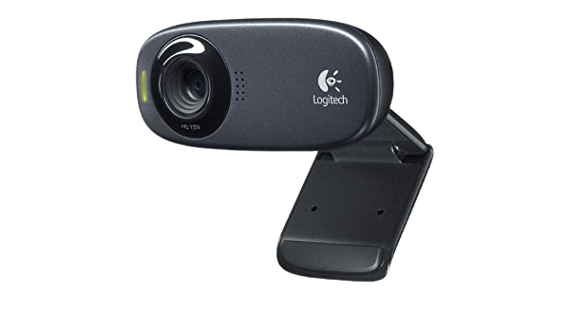
BUDGETING
Raspberry Pi 4 (4GB RAM)
Rs. 4969
Rs. 95
Breadboard
Logitech Webcam
Rs. 1995

Slide 9
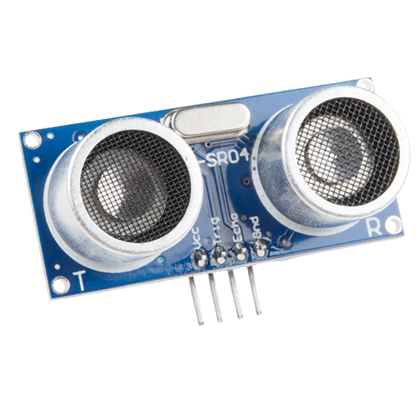
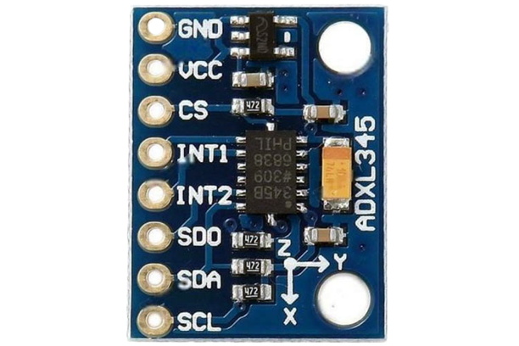
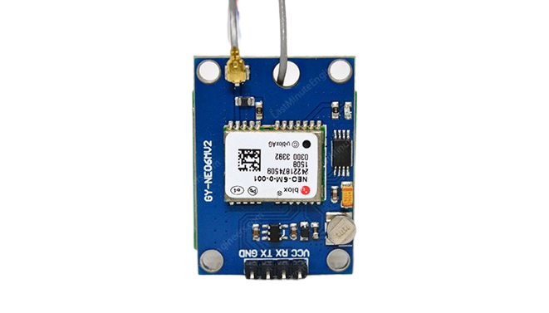
Ultrasonic Distance Sensor
Rs. 72
Rs. 125
BUDGETING
ADXL345- Accelerometer
Rs. 265
GPS Neo 6M Module

Slide 10
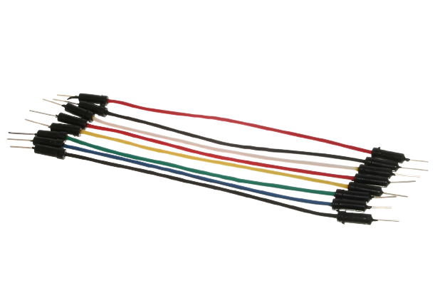
Jumper Wires
Rs. 159
Rs. 285
BUDGETING
Tubelight Holder

Slide 11
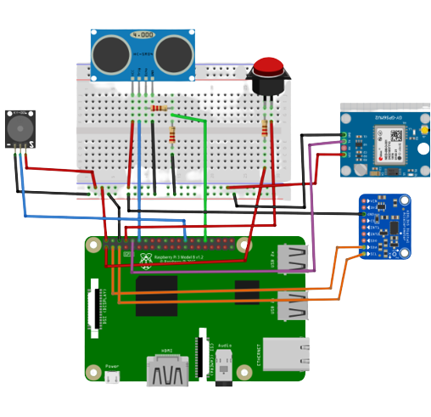
Circuit Design

Slide 12
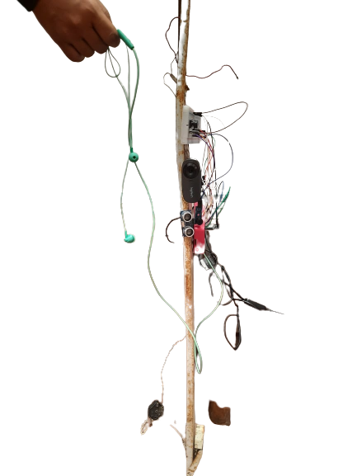
Working prototype

Slide 13
THANK YOU!

